Slide 1

Capstone Project :
VRRP Based Network Redundancy
Presented By :
Prashanth.G (192524072),
Arshad Syed (192525060),
Kamali.SI (192512093)

Slide 2
Table of Contents
Abstract
Introduction to VRRP
Need for Failover Routing
How VRRP works
VRRP Architecture
VRRP Configuration
Priority & Preemption
Result & Outcome
Conclusion

Slide 3

Abstract
This project explores the implementation of VRRP (Virtual Router Redundancy Protocol) to ensure continuous network availability.
VRRP provides automatic router failover in Local Area Networks (LANs) by electing a Master router and one or more Backup routers to manage the default gateway.
This mechanism guarantees that network communication remains undisrupted even during the failure of a primary router, enhancing network resilience and reliability.

Slide 4
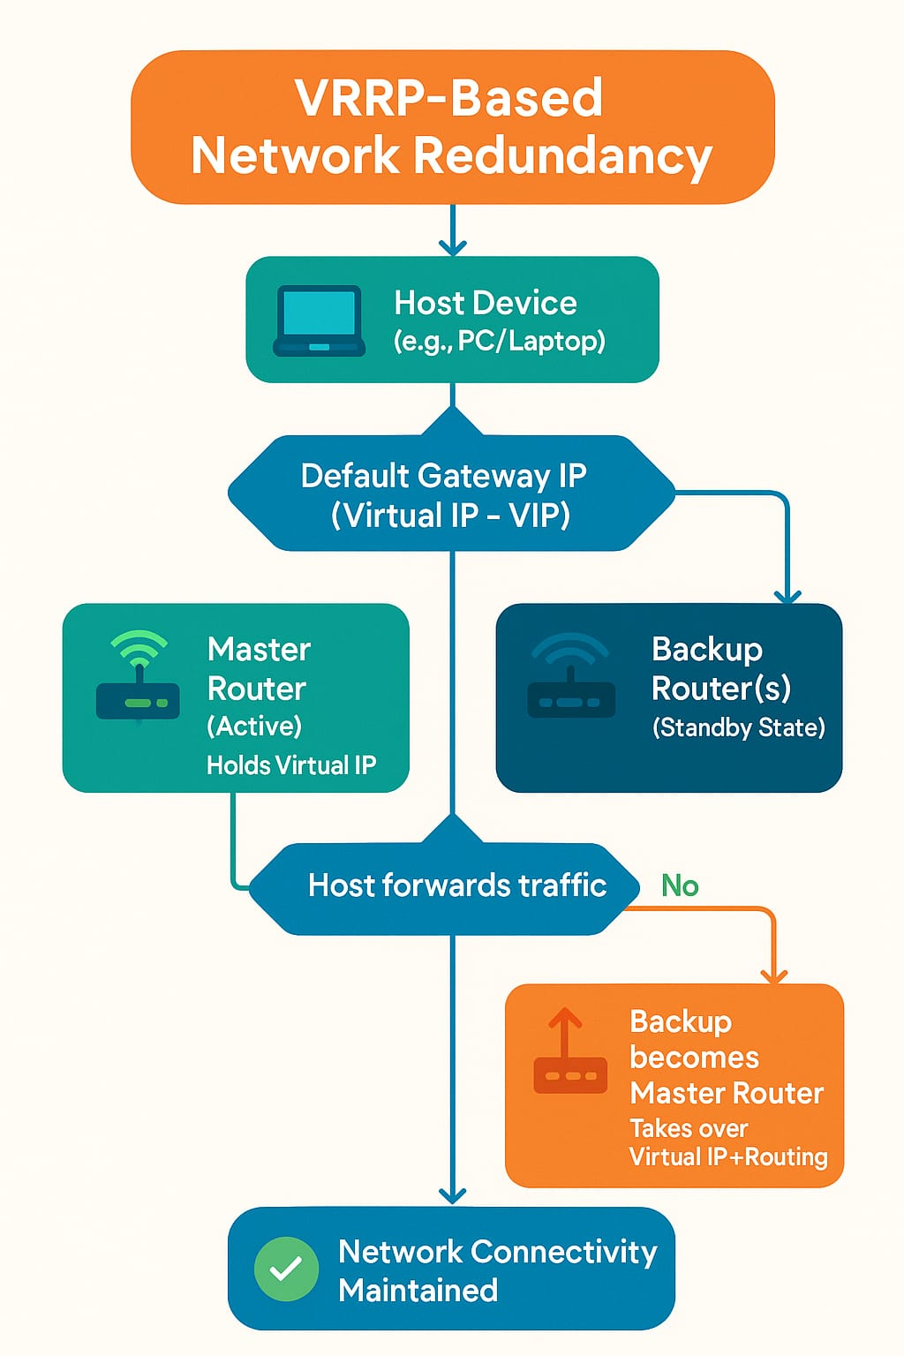
Introduction to VRRP
RFC 5798 VRRP - virtual router IP address - shared among multiple physical routers.
One router - Master - handling all network traffic.
Other routers function – Backups - Standby state -
Master router fail - one of the Backups - takes over control.
Ensuring uninterrupted gateway redundancy and maintaining network connectivity for end devices.

Slide 5





How VRRP Works (Failover Routing)
Router Grouping
Multiple physical routers are configured within a single VRRP group.
Virtual IP Sharing
They share a common Virtual IP address, which clients use as their default gateway.
Master & Backup Roles
One router becomes the Master (active), handling all traffic, while others are Backups (standby).
Hello Messages
All routers periodically send VRRP advertisement (hello) messages to monitor each other's status.
Failover Trigger
If the Master router stops sending advertisements (fails), the Backup router with the highest priority
assumes the Master role.

Slide 6
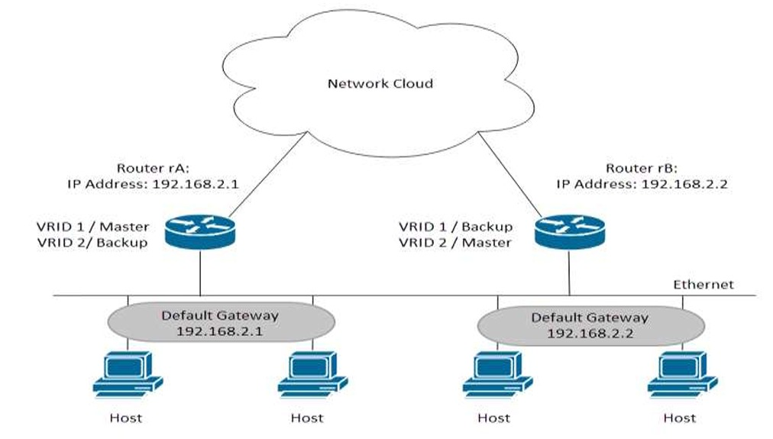
Need for Failover Routing
Failover routing is critical for modern network infrastructures, preventing a single point of failure at the default gateway.
This significantly increases network uptime and reliability, minimizing service disruptions.
It also reduces the need for manual intervention during network faults, thereby lowering operational costs and response times.
Failover routing is indispensable for mission-critical network services where continuous availability is paramount, ensuring smooth and consistent network operation.

Slide 7
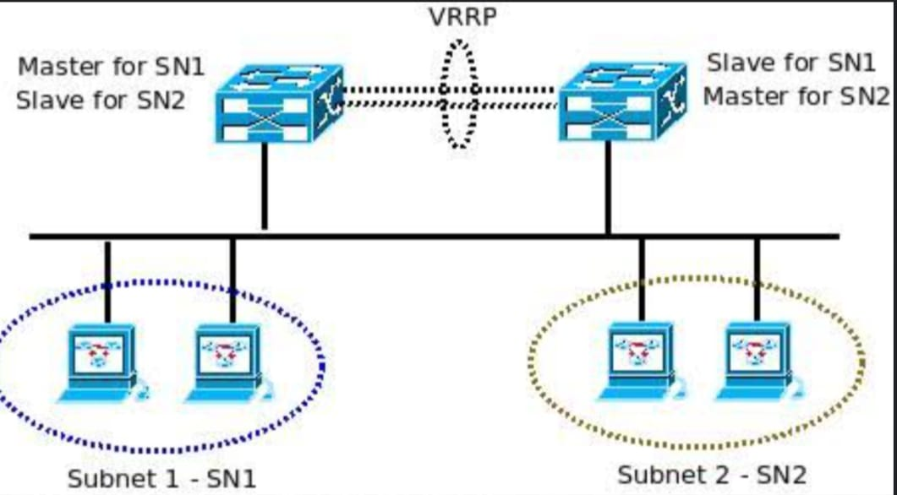
VRRP Architecture
The core of VRRP architecture involves a Virtual IP assigned to a group of routers, forming a VRRP group.
Within this group, one router is designated as the Master (active), responsible for forwarding traffic for the virtual IP address.
The remaining routers operate as Backups (standby), passively monitoring the Master's status.
The Master router periodically sends multicast advertisements to its Backups.
If these advertisements cease, a Backup router automatically takes over the Master role, ensuring automatic and seamless failover for network users.

Slide 8

Priority & Preemption
VRRP priority is a crucial parameter, ranging from 0 to 255, with a default value of 100.
The router configured with the highest priority value is elected as the Master.
Preemption is a configurable feature that, when enabled, allows a router with a higher priority to immediately take over the Master role from a lower-priority Master, even if the current Master is operational.
A priority of 0 is reserved and indicates that the router cannot be elected Master.
Interface tracking can be configured to dynamically decrease a router's priority if a monitored interface goes down, ensuring faster failover in case of critical link failures.

Slide 9
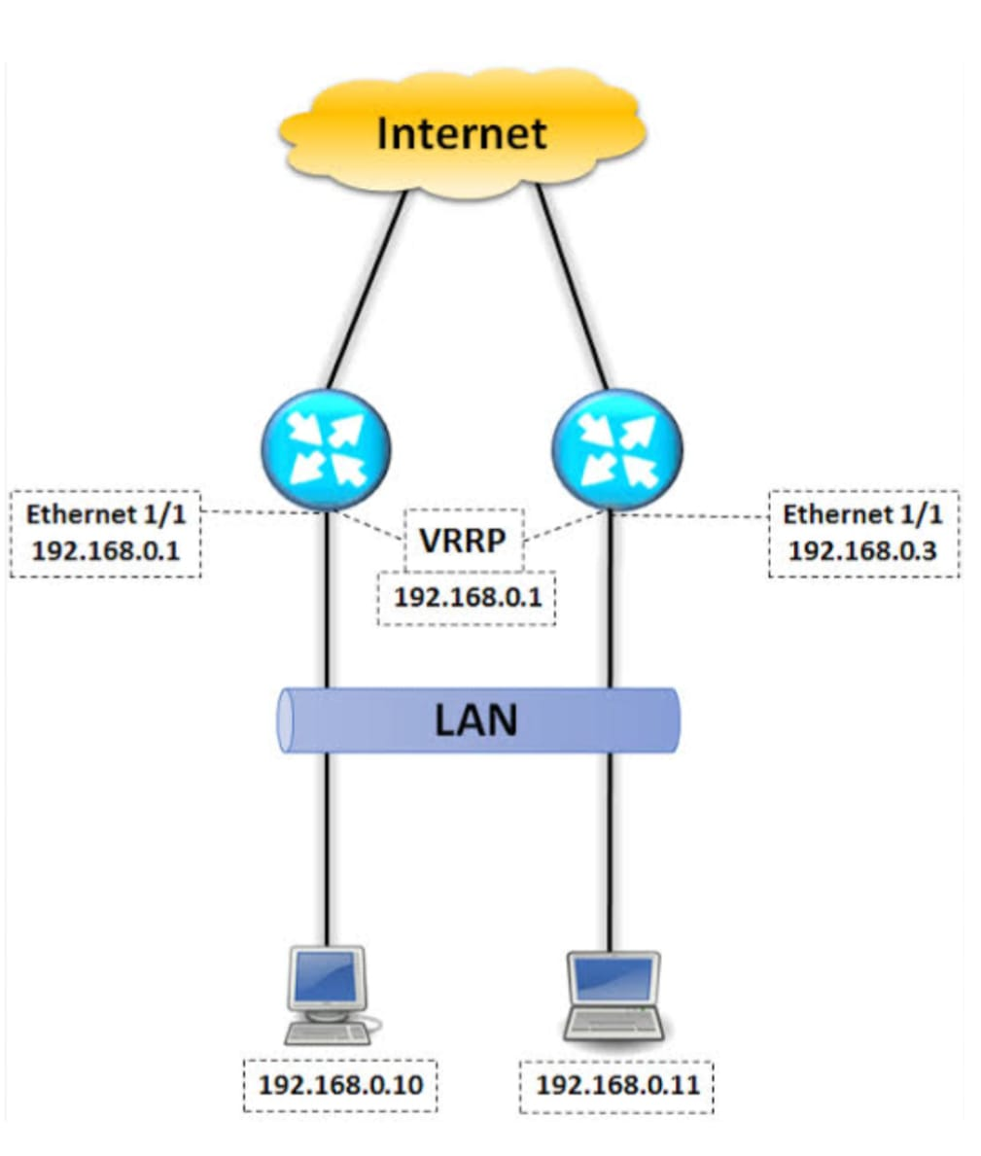
VRRP Configuration
Configuring VRRP involves several key steps :
First, define a common virtual IP address for all routers within the VRRP group next, assign a priority value to each router; the router with the highest priority (e.g., 255) is preferred as the Master.
Enable preemption to allow a higher-priority router to reclaim the Master role if it recovers.
Implement interface tracking to dynamically adjust router priorities based on link status.
These configurations are typically performed using network simulation tools like Cisco Packet Tracer or GNS3, or directly on network devices via command-line interfaces.

Slide 10

Result & Outcome
Our Packet Tracer simulation successfully demonstrated a functional VRRP failover system using two routes.
When the primary (Master) router was intentionally taken offline, the Backup router instantly assumed the Master role, ensuring no disruption in network traffic for connected clients.
Upon the restoration of the original Master router, the system gracefully reverted, with the higher-priority Master reclaiming its active role due to preemption.
This setup achieved a rapid failover time of approximately 3 seconds, validating the effectiveness of VRRP in providing high network availability.

Slide 11

Conclusion
Ensures continuous network availability and uptime.
Eliminates single points of failure at the default gateway.
Achieves rapid, automatic failover, minimizing service disruption.
Reduces manual intervention during network incidents.
Enhances overall network resilience and reliability.
Offers a cost-effective solution for high-availability needs.
Proves indispensable for mission-critical applications.
This project validates VRRP as a cornerstone for modern, resilient network infrastructures.

Slide 12

THANK YOU !

